Slide 1
DBMS- Session4

Slide 2
Session Objective
To understand Transaction
DataWarehousing
Data Mining
OLTP
OLAP
BigData
Hadoop

Slide 3
Trasaction
Logical unit of program execution that takes a database from one consistent state to another consistent state
BEGIN
While executing
Active
After the final
When normal
statement
execution can’t
has been
proceed
executed
Partially
F
ailed
completed
After rolling
back and
After
restoration to
successful
previous state
completion
Committed
Aborted

Slide 4
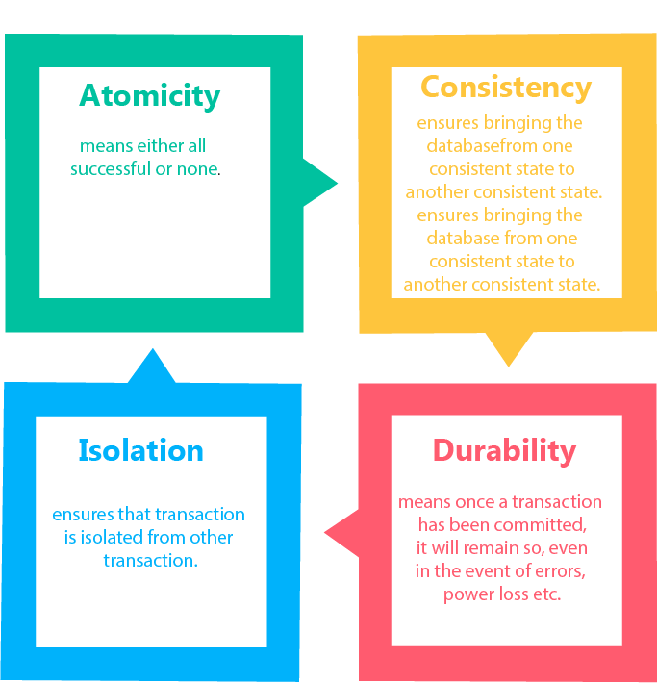
Transaction Properties
Atomicity
Consistency
Isolation
Durability

Slide 5
Data Warehousing
A data warehouse is built to store large quantities of historical data and enable fast, complex queries across all the data, typically using Online Analytical Processing (OLAP).
A database was built to store current transactions and enable fast access to specific transactions for ongoing business processes, known as Online Transaction Processing (OLTP)
Dimensions define
the When, Who, Where,
Why of business Data
Facts/Measures contains
the How much and How many
of Business Data
Data Warehouse

Slide 6
Data Warehousing
Definition:
“A data warehouse is a subject-oriented, integrated, time-variant and nonvolatile collection of data in support of management’s decision-making process”.
- William, H Inmon
Subject-oriented:
Focusing on the modeling and analysis of data for decision makers, not on daily operations or transaction processing.
Integrated:
Integrate data from multiple data sources.
Time Variant:
All data in the data warehouse is identified with a particular time period.
Non-volatile
Data is stable in a data warehouse
https://www.intricity.com/data-warehousing-videos/
Notes:
Data: symbols Information: data that are processed to be useful; provides answers to "who", "what", "where", and "when" questions Data... data is raw. It simply exists and has no significance beyond its existence (in and of itself). It can exist in any form, usable or not. It does not have meaning of itself. In computer parlance, a spreadsheet generally starts out by holding data.
Information... information is data that has been given meaning by way of relational connection. This "meaning" can be useful, but does not have to be. In computer parlance, a relational database makes information from the data stored within it.

Slide 7
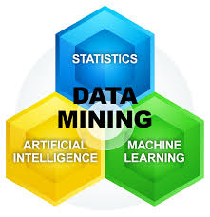
Data Mining
It is the process of extracting previously unknown, comprehensible and actionable information from large data warehouses and uses it to make a crucial business decision.
The information or knowledge extracted so can be used for any
of the following applications −
Market Analysis
Fraud Detection
Customer Retention
Production Control
Science Exploration

Slide 8
Data Mining
Process of Data Mining:
Data mining process is break down into below 5 stages:
Data Exploration/ Gathering: Identify data from different data sources and load it to decentralized data warehouses.
Store and Manage Data: Store the data in distributed storage (HDFS), in-house servers or in a cloud (Amazon S3, Azure).
Modeling: Business team, Developers will access the data and apply sampling and transformation in data and remove corrupt, irrelevant, inaccurate, incomplete data.
Deploying Models: Based on the results from modeled data sort the data based on users expectations or results.
Visualize Data: Presents the data in the graphs or tables or charts or decision tree format so that end users can understand.

Slide 9
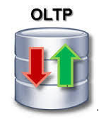
OLTP
OLTP (Online Transaction Processing) is a class of software programs capable of supporting transaction-oriented applications on the Internet.
The main focus of OLTP system is to record the current Update, Insertion and Deletion while transaction.
An important attribute of an OLTP system is its ability to maintain concurrency. To avoid single points of failure, these systems are often decentralized.
The best example for OLTP system is an ATM, in which using short transactions we modify the status of our account. OLTP system becomes the source of data for OLAP.

Slide 10
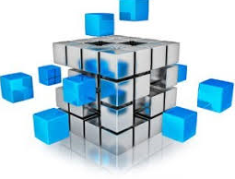
OLAP
OLAP (online analytical processing) is a computing method that enables users to easily and selectively extract and query data in order to analyze it from different points of view.
OLAP business intelligence queries often aid in trends analysis, financial reporting, sales forecasting, budgeting and other planning purposes.
OLAP can be used for data mining or the discovery of previously undiscerned relationships between data items.
An OLAP database does not need to be as large as a data warehouse, since not all transactional data is needed for trend analysis.

Slide 11
OLTP Vs OLAP
OLTP | OLAP
OLTP is an online transaction system. | OLAP is an online data retrieval and analysis system.
Online transactional data becomes the source of data for OLTP. | The different OLTPs database becomes the source of data for OLAP.
OLTP’s main operations are insert, update and delete. | OLAP’s main operation is to extract multi dimensional data for analysis.
The tables in OLTP database must be normalized (3NF). | The tables in OLAP database may not be normalized.
As OLTPs frequently executes transactions in database, in case any transaction fails in middle it may harm data’s integrity and hence it must take care of data integrity. | While in OLAP the transaction is less frequent hence, it does not bother much about data integrity.

Slide 12
OLTP Vs OLAP Visualization
Operational User
Operations
Business
Processes
OLTP
Database
OLTP
Business Decisions
OLAP
Extraction
Cleansing
Conforming
and
Dimensional
Storage
Management User
Analysis
Data Warehousing
Notes:
Data: symbols Information: data that are processed to be useful; provides answers to "who", "what", "where", and "when" questions Data... data is raw. It simply exists and has no significance beyond its existence (in and of itself). It can exist in any form, usable or not. It does not have meaning of itself. In computer parlance, a spreadsheet generally starts out by holding data.
Information... information is data that has been given meaning by way of relational connection. This "meaning" can be useful, but does not have to be. In computer parlance, a relational database makes information from the data stored within it.

Slide 13
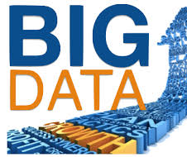
BIG DATA
Big data is the term for the collection of datasets so large and complex that it becomes difficult to process using on-hand database management tools or traditional data processing applications.
Big data comes in various formats accumulating at tremendous speeds and growing in size exponentially.
Volume
Velocity
Variety

Slide 14
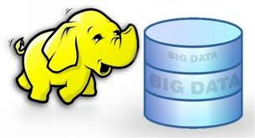
Hadoop
Hadoop is an open source distributed processing framework that manages data processing and storage for big data applications running in clustered systems.
It is at the center of a growing ecosystem of big data technologies that are primarily used to support advanced analytics initiatives, including predictive analysis, data mining and Machine learning applications.
Hadoop can handle various forms of structured and unstructured data, giving users more flexibility for collecting, processing and analyzing data than relational databases and data warehouses provide.
Notes:
Data: symbols Information: data that are processed to be useful; provides answers to "who", "what", "where", and "when" questions Data... data is raw. It simply exists and has no significance beyond its existence (in and of itself). It can exist in any form, usable or not. It does not have meaning of itself. In computer parlance, a spreadsheet generally starts out by holding data.
Information... information is data that has been given meaning by way of relational connection. This "meaning" can be useful, but does not have to be. In computer parlance, a relational database makes information from the data stored within it.

Slide 15

Video on Hadoop
Objective:
To make the Trainee to understand the concept of Hadoop with story.
Video Path:
Hadoop, the story:
https://www.youtube.com/watch?v=h2LzEvPU4jY

